Slide 1



STOCK ANALYSIS by SACHIN KHAJURIA
</
} /> [

Slide 2
CONTENTS:
Pipe Line Overview for the Current Project
Hive Scenarios
Optimization Techniques
Walmart Stock Scenarios
Challenges Faced
Insights from Stock Datasets

Slide 3

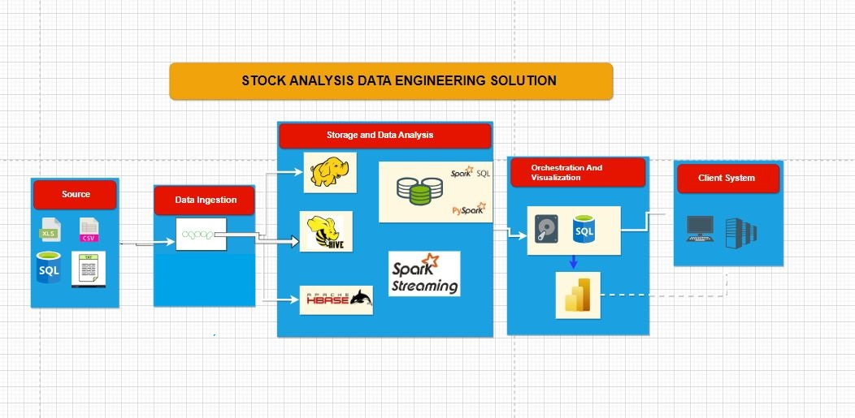



Spark Pipeline

Slide 4
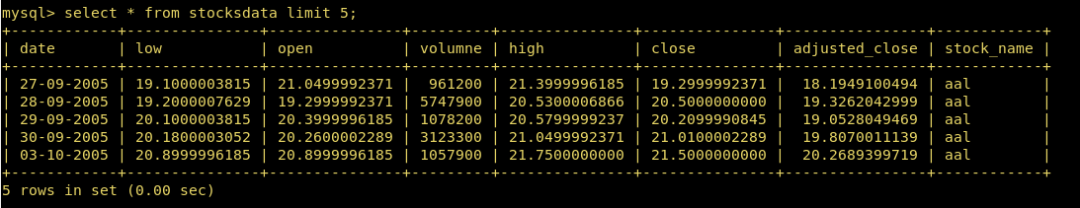
STRUCTURE OF THE DATA
5 different datasets:
Types of Processing:
BATCH
ONLINE
STREAMING
INTERACTIVE
- AAL
- ABIO
- AAOI
- ABMD
- WALMART

Slide 5
SQOOP PIPELINES USED IN THE PROJECT
Importing data from MySql to hive Data-warehouse
Exporting external tables to mysql
Importing Data from MySql to HBASE

Slide 6
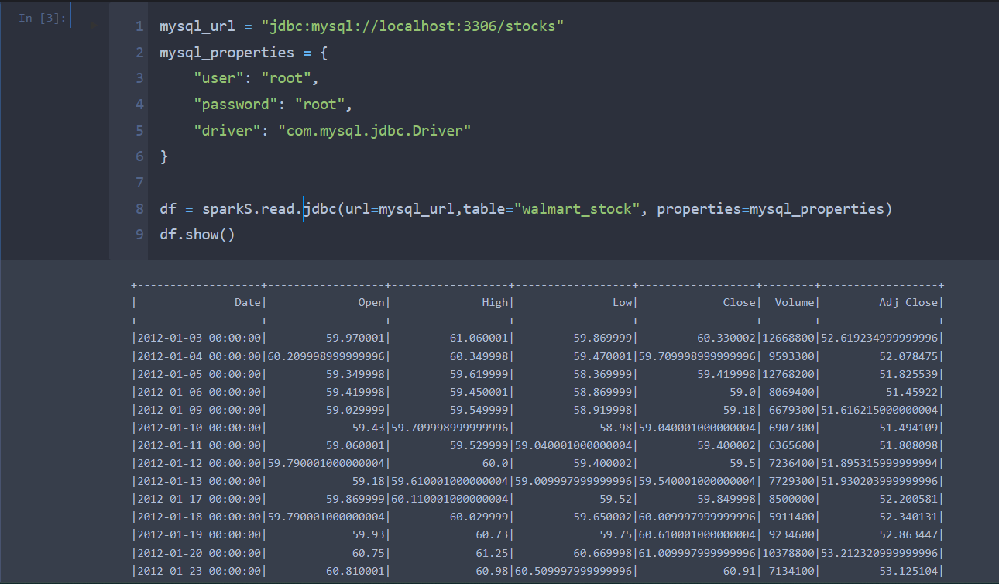
SPARK PIPELINE USED IN THE PROJECT

Slide 7
HIVE SCANERIOS
Write a Hive query to identify the top three dates that experienced the largest percentage change in stock price (from open to close) for every stock.
Write a Hive query to identify the dates where Low is less than average month low for every stock.
Write a Hive query to find the date with the longest consecutive streak of increasing closing prices for every stock.
Write a Hive query to find the dates where AAL open price is higher than AAOI open price OR AAL volume greater than AMBD (write your query in an optimised way).
Write a Hive query to calculate VH ratio(volume to high ratio).
Write a Hive query to find the dates where previous day close and current day open difference is greater than 0 for each stock.
Find median of volume for ABIO.

Slide 8
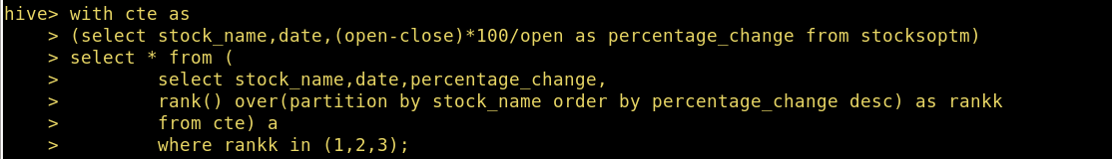
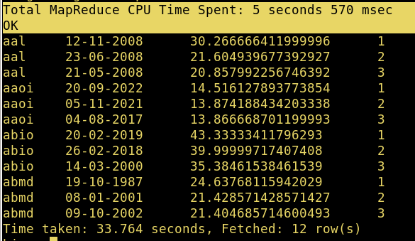
Write a Hive query to identify the top three dates that experienced the largest percentage change in stock price (from open to close) for every stock.

Slide 9
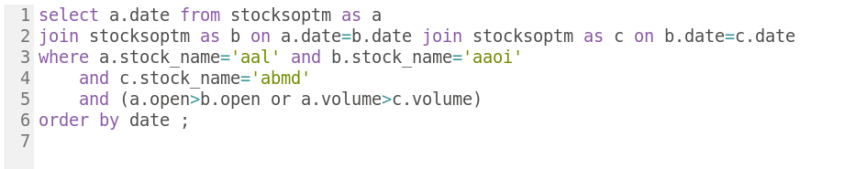
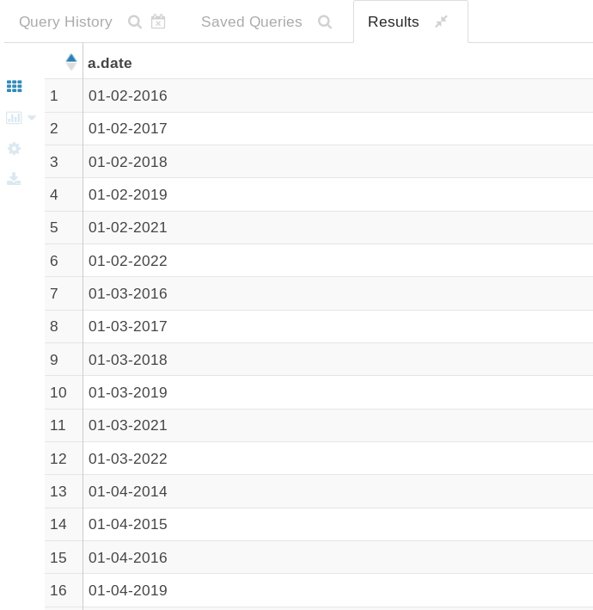
write a Hive query to find the dates where AAL open price is higher than AAOI open price OR AAL volume greater than AMBD (write your query in an optimized way).

Slide 10
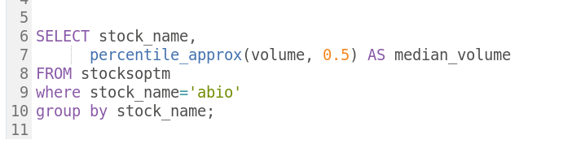
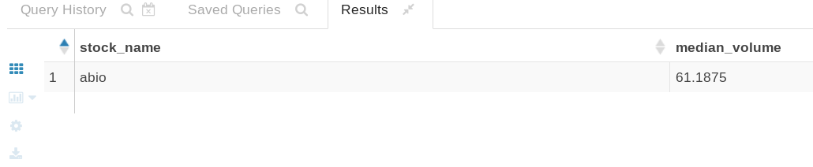
Find median of volume for ABIO.

Slide 11

PARTITIONING
Partitioning involves dividing data into logical partitions based on one or more columns. Each partition is stored as a separate directory or subdirectory in the Hive warehouse directory. Partitioning is useful when you have a large dataset and want to efficiently filter and query the data based on specific partition criteria.
BUCKETING
Bucketing, also known as clustering, is a technique used to distribute data into a fixed number of buckets based on a column's hash value. It is useful when you want to evenly distribute the data across multiple files or reduce the data skew for better query performance. Unlike partitioning, which creates separate directories for each partition, bucketing groups data within the same partition into buckets.

Slide 12
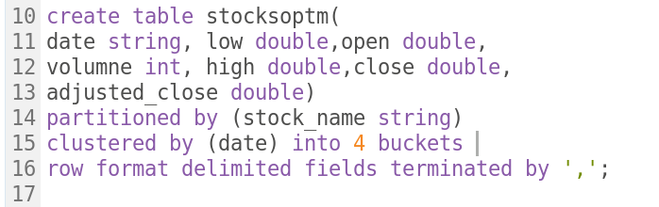
Implementation of Optimization Techniques
I am creating partitioning as well as buckets on the table to improve optimization, I have created partition on column named stock_name and made a bucket on the date column with 4 buckets.

Slide 13
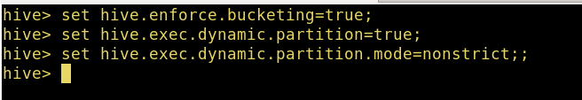
Activating the partitioning and bucketing in hive as its not activated by default using commands:
Inserting data into the newly created partitioned table named stocksoptm.

Slide 14

scenario 1: print out first 5 columns ?
scenario2:There are too many decimal places for mean and stddev in the describe() dataframe. Format the numbers to just show up to two decimal places. Pay careful attention to the datatypes that .describe() returns, we didn't cover how to do this exact formatting, but we covered something very similar. Check this link for a hint.
scenario3: Create a new dataframe with a column called HV Ratio that is the ratio of the High Price versus volume of stock traded for a day?
scenario4: What day had the Peak High in Price?
scenario5: What is the mean of the Close column?
scenario6: What is the max and min of the Volume column?
scenario7: How many days was the Close lower than 60 dollars?
Scenario8:What percentage of the time was the High greater than 80 dollars ?In other words, (Number of Days High>80)/(Total Days in the dataset)
Scenario9:What is the max High per year?

Slide 15
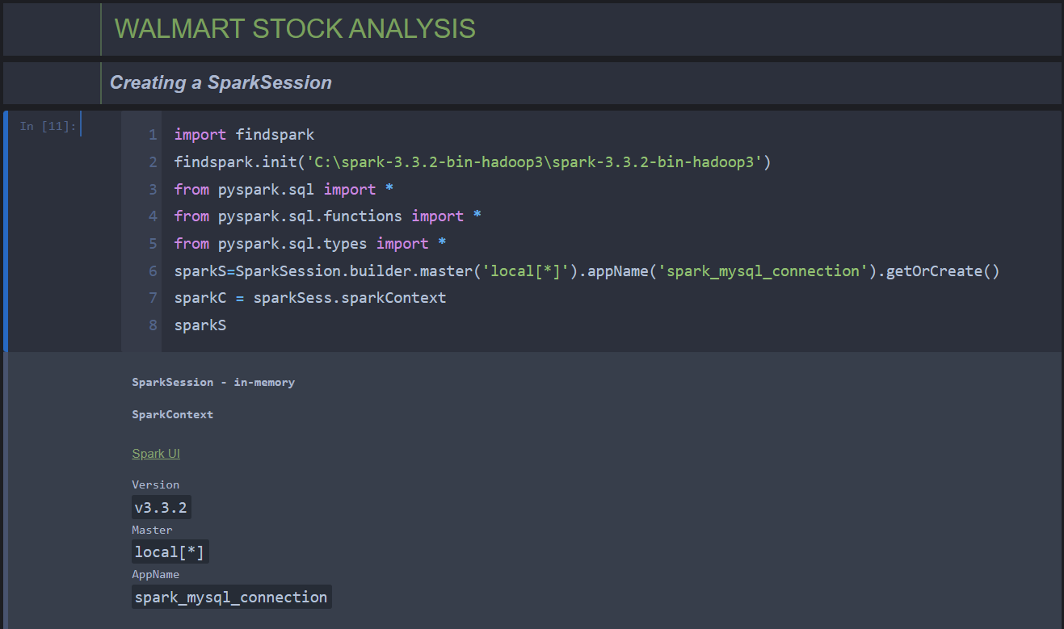

Slide 16
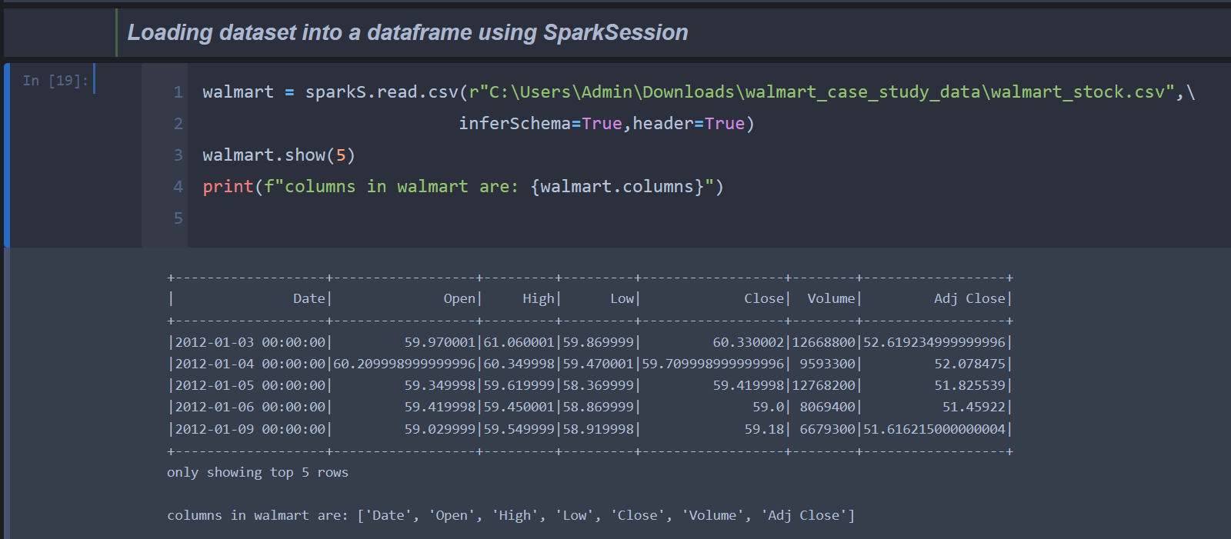

Slide 17
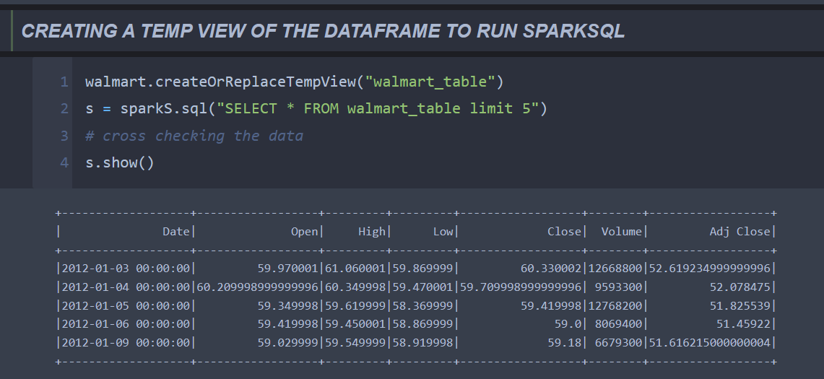

Slide 18
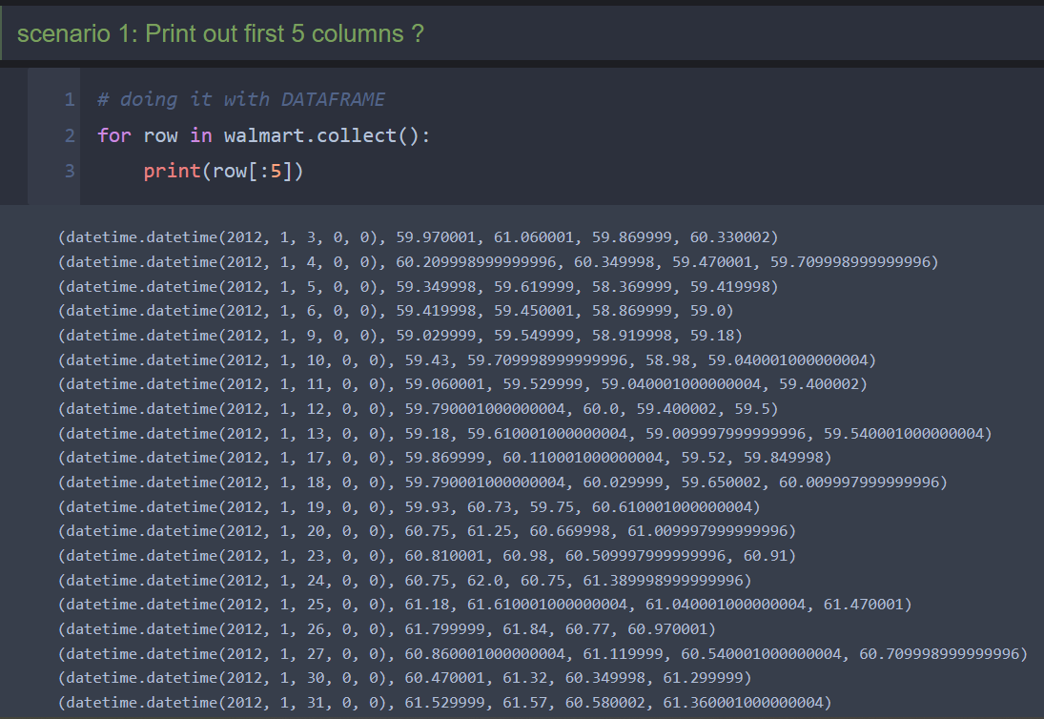

Slide 19
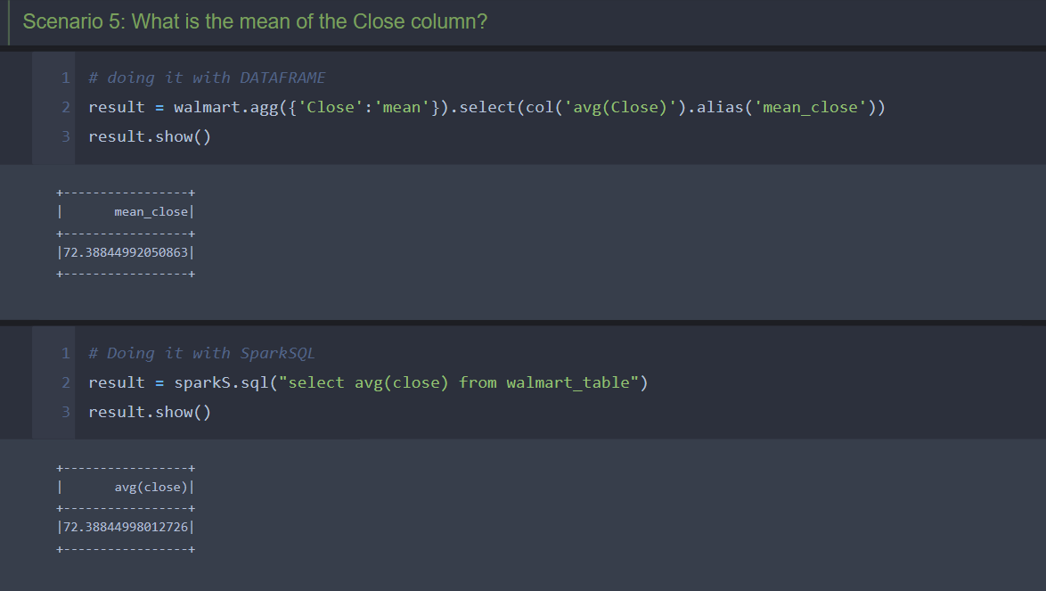

Slide 20
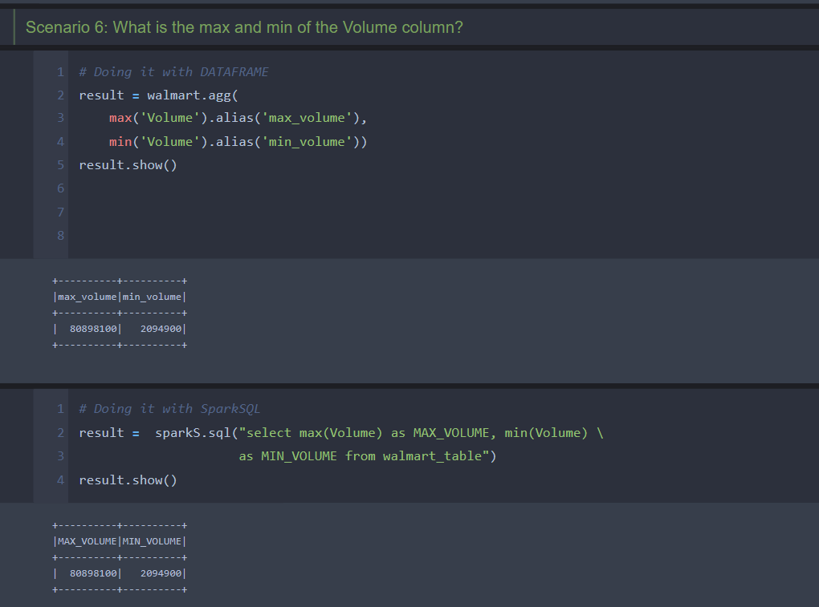

Slide 21
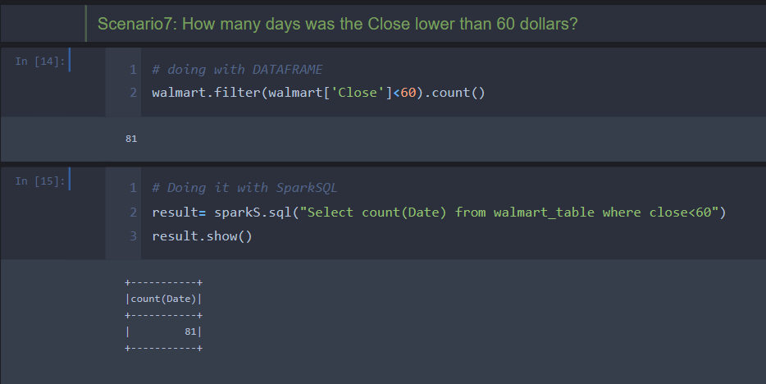

Slide 22
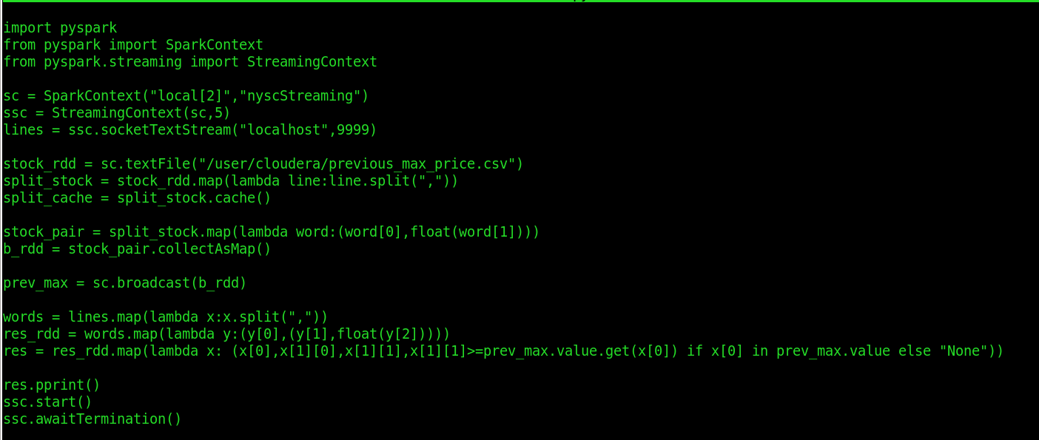
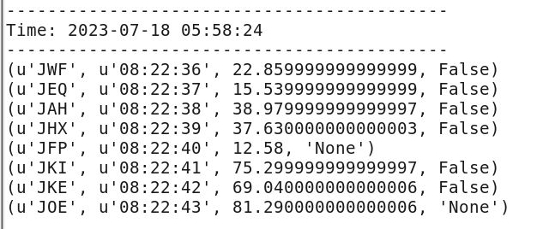
SPARK STREAMING
Compare the current stock prices with the max price of the stock and return a Boolean value

Slide 23
Challenges Faced
Partition Inefficiency: Inefficient partitioning in Hive impacted query performance and data retrieval due to factors like improper partition key selection or unoptimized partitioning strategies.
Deciding the Partition: Selecting the right columns for partitioning was challenging,
requiring careful consideration of data characteristics, query patterns, and specific use cases.
Exporting Table from MySQL to Hive: Transferring data from MySQL to Hive posed complexities, including data integrity, schema mapping, and addressing inconsistencies or compatibility issues.
Complex Query Execution in Hive: Executing complex queries in Hive, especially those involving joins, subqueries, or intricate transformations, required extensive analysis and modifications for optimal performance.

Slide 24
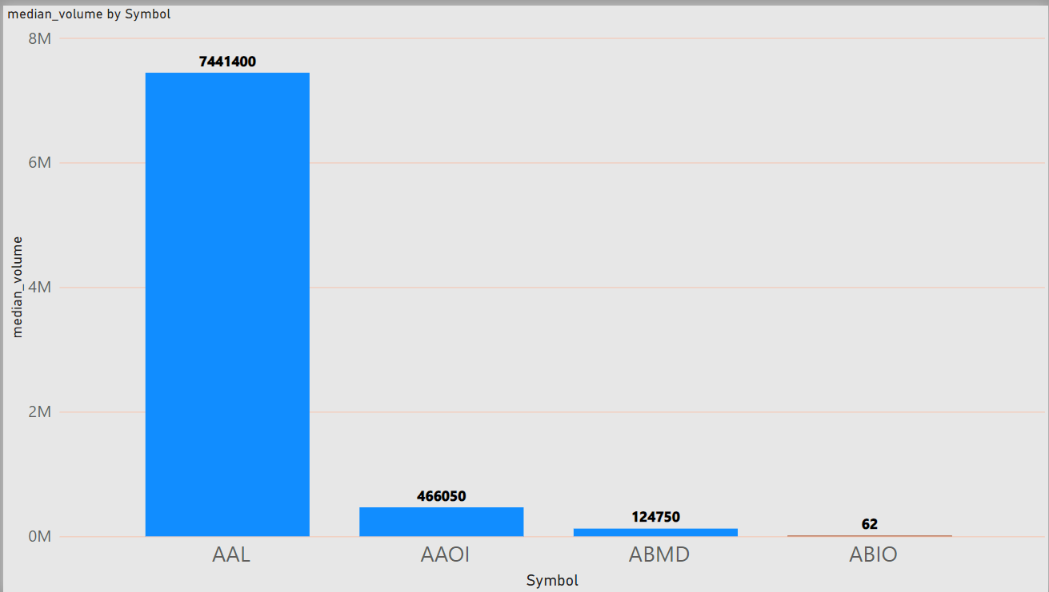
Insights:
Median Volume per stock
1. AAL has the highest median Volume, hence it can be observed that this stock was more volatile than others

Slide 25
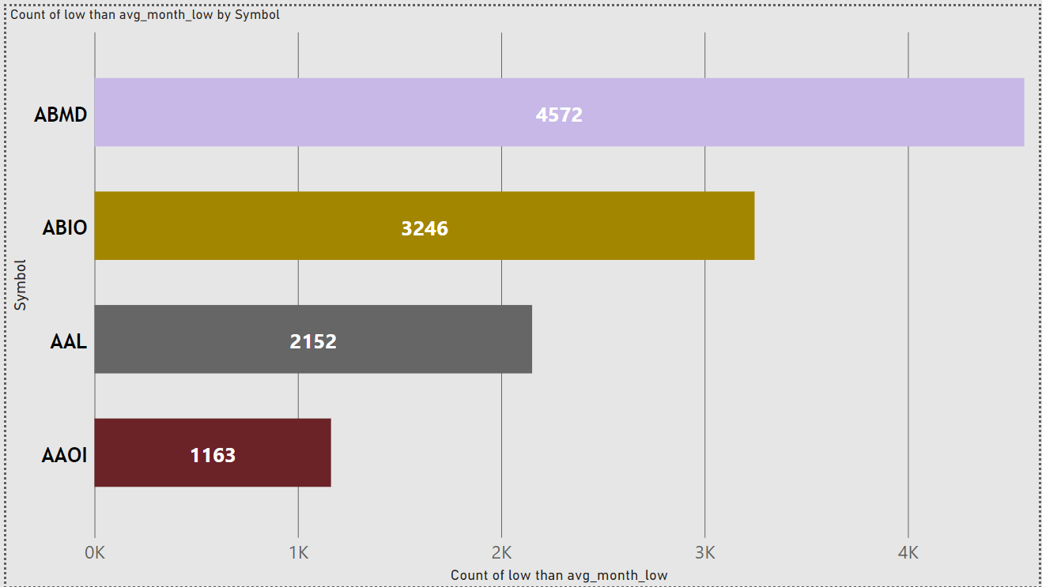
Count of low than AVG-Month low per stock
- It can be observed from the given graph that ABMD faced maximum low compared to others.
- So any intraday traders should avoid trading with the stocks if they are choosing the upward trend

Slide 26
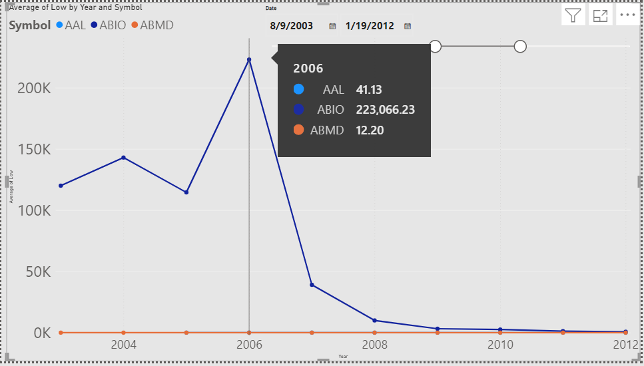
AVG of LOW by year for every stock
It can be observed from the given graph that AABIO’s avg low price is for a particular year is far greater than other stocks, but if you compare after 2006 its showing a downtrend and investors should check on the stock before investing.

Slide 27
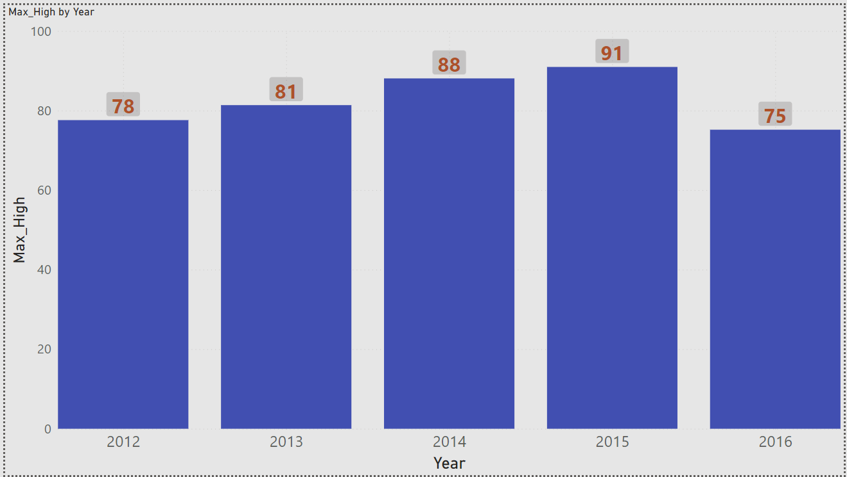
Max High Per year (WALMART STOCK)
It can be observed from the given graph that the Walmart stock is showing a upward trend from 2012-2015 and is entering into a downward trend in the year 2016.

Slide 28
THANKYOU!

